Slide 1

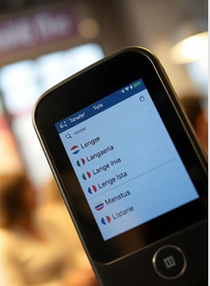
Real – Time Language Translator Using Java
This project delves into the development of a real-time language translator using Java, aiming to overcome language barriers and facilitate seamless communication in diverse environments.
Team Members :
Preeti Devi
Mitali Singh
Sakshi Garg
Raushan kumar

Slide 2
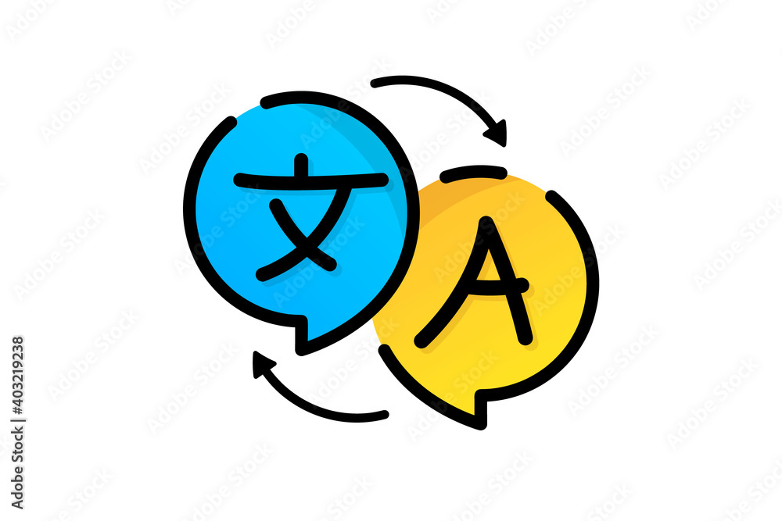
Introduction To Real -Time Language Translator
1- Communication Challenges Language barriers hinder effective communication and understanding between individuals and communities, leading to misunderstandings and limitations in collaboration.
2 -Social & Economic Impact Language barriers impact social inclusion, business opportunities, and international relations, creating significant obstacles in a globalized world

Slide 3

Objective
1 - To develop a real-time language translation application that enables seamless communication between users speaking different languages.
2- To enhance accessibility and facilitate understanding in global communication.

Slide 4
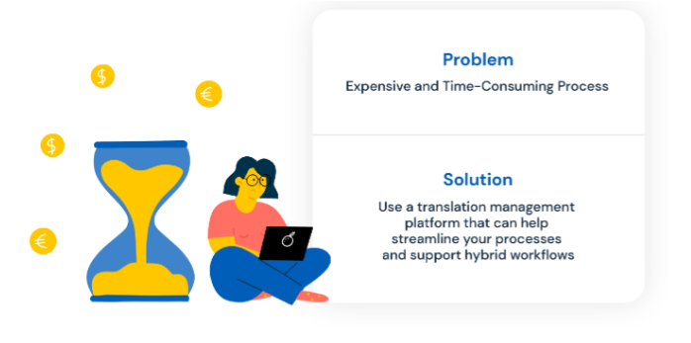
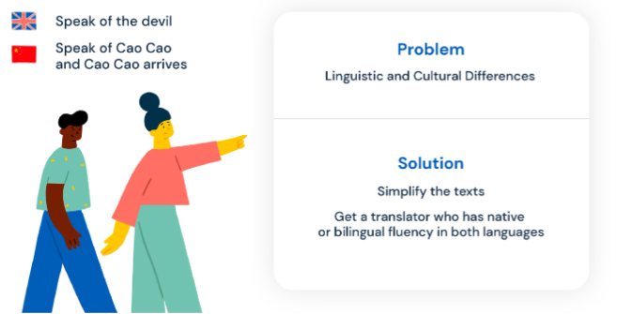
Problem Statement
Problem 1:
Problem 2 :

Slide 5
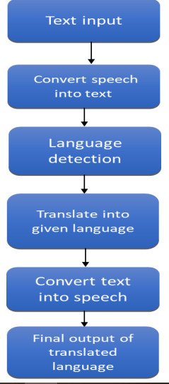
Flow Diagram
Step 1: Select the language
Step 2: Input the text/speech that want to translate
Step 3: convert the speech into text
Step 4: language detection
Step 5: translate into given language
Step 6: convert speech into text
Step 7: output of translated language

Slide 6
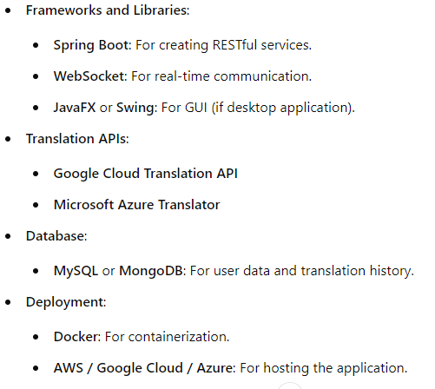
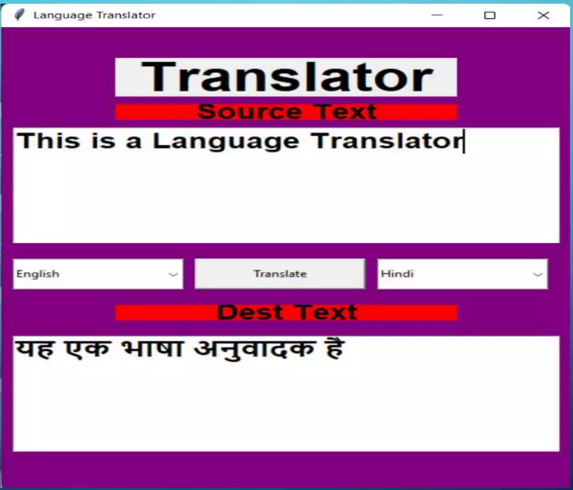
Technical Stacks

Slide 7
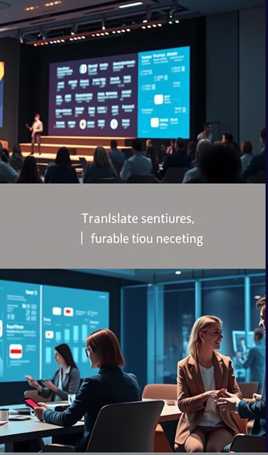
Conclusion and future development
Impact : The real-time language translator will bridge communication gaps and enhance user interactions across different languages.
Future Scope: Incorporate machine learning for improved translation accuracy.
Expand support to include more languages and dialects.
Enhance user interface for better usability and accessibility.

Slide 8
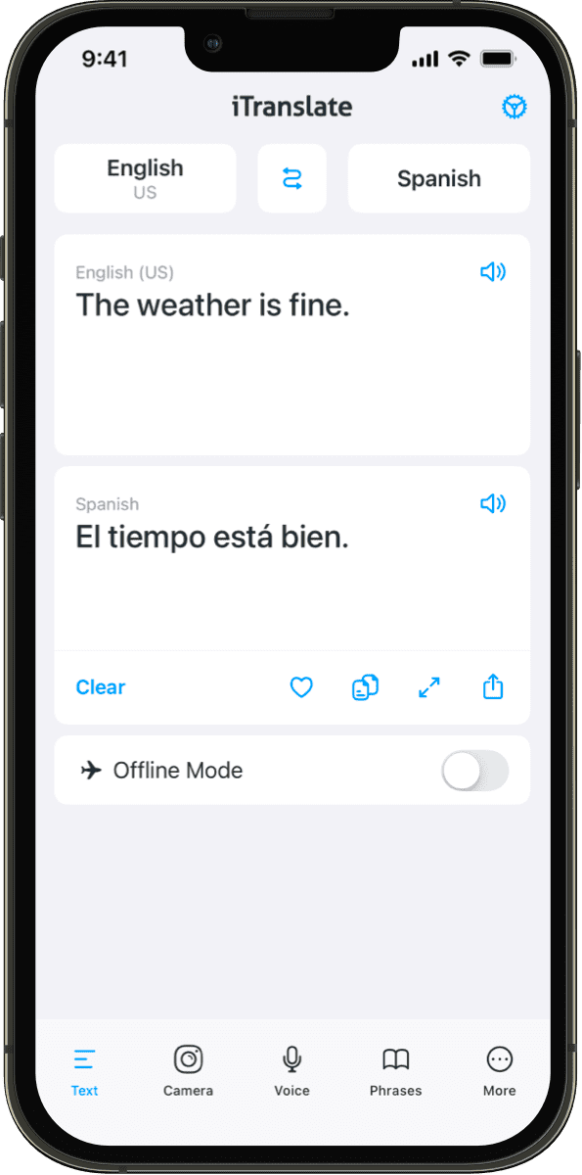
Thank You

